Slide 1
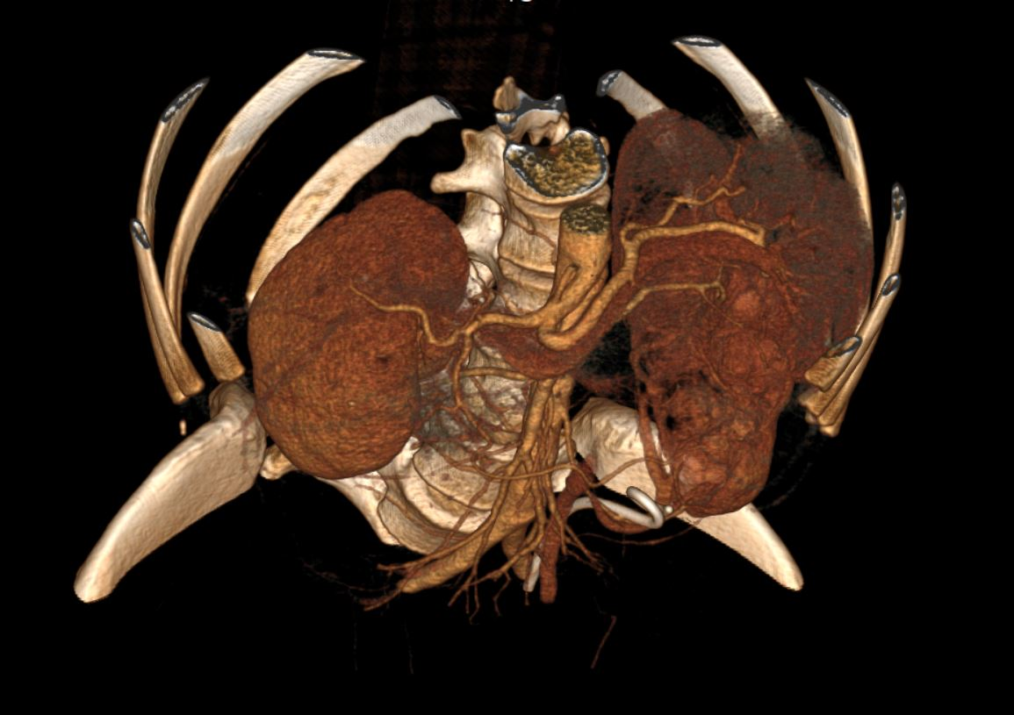
Lesion Detection and Analysis in CT Scan images
FYP PROJECT Members
ABDUL MASOOD - i160312 SLAHUDDIN CH - i160060
Supervised By
DR. M Adnan TARIQ

Slide 2

An average patient gets a report around 24 hours after undergoing the scan which is a long time for someone with a critical medical condition.

Slide 3
WHY AUTOMIZATION?
It takes hours to analyze a single CT scan image.
Leads to inefficient utilization of CT Machine
A radiologist analyzes hundreds of similar CT scans daily
Accuracy and time
Automatic lesion detection
The project does not intend to replace radiologists rather it makes their job easier and efficient.

Slide 4
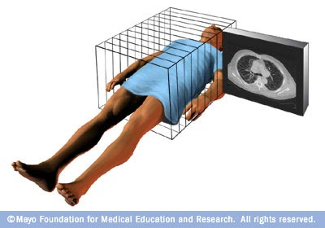
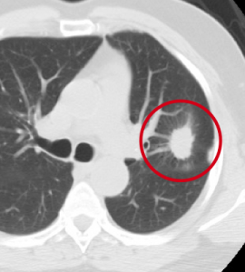
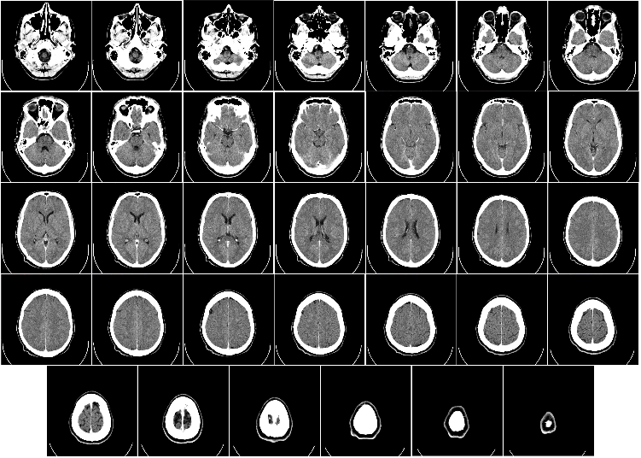
Traditional Approach

Slide 5
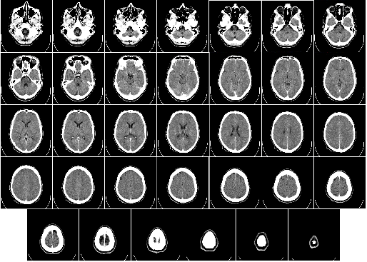
Proposed Solution
Step 1
- Labelled Data collection
Starting with skull CT for simplicity
DATA Sources
AL- Razi Labs
Anmol Hospital Lahore
NIH US
https://cancerimagingarchive.net
PIMS and AL-Shifa

Slide 6
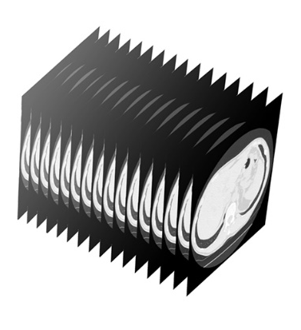
Proposed Solution
Step 2
Using PiDICOM to stack pixel data of slices to make a multi dimensional array

Slide 7
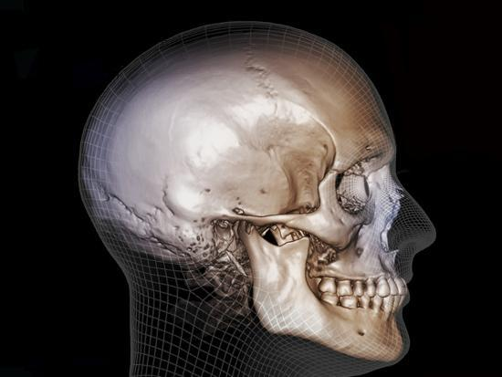
Proposed Solution
Step 3
Construing Visualization

Slide 8
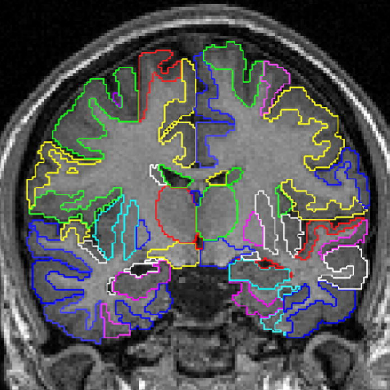
Proposed Solution
Step 4
Using segmentation to Identify boundaries of Organs

Slide 9
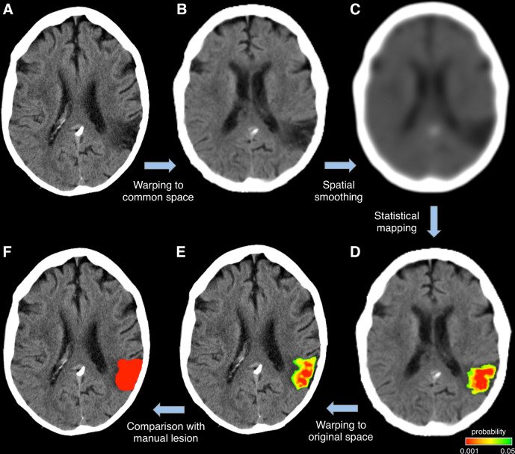
Proposed Solution
Step 5
Detecting Lesion
Identifying boundaries of Lesion
Identifying surface type of Lesion
Identifying Location of Lesion
Identifying if

Slide 10
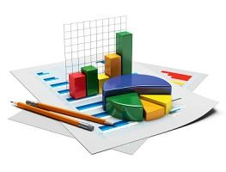
Proposed Solution
Step 6
Create a Desktop Application
Takes dicom images as input
Generate dicom image in 3D with highlighted lesion
Report size, type, surface type and location of lesion if found

Slide 11
Proposed Solution
Step 1
Step 2
Step 3
Step 4
Step 5
Step 6

Slide 12
Timeline

Slide 13
Months | Workflow | Artifacts
September | Data Scraping | Requirement Gathering
October | Data Preprocessing & Categorization | Requirement Gathering Design & Analysis
November, December | Algorithm for Object Segmentation | Requirement Gathering Design & Analysis Implementation
January, February | Model Training | Requirement Gathering Design & Analysis Implementation
March | Dynamic Learning & Building Desktop Application | Requirement Gathering Design & Analysis Implementation Test
April | Efficient Responsiveness | Requirement Gathering Design & Analysis Implementation Integration & Test

Slide 14
Expertise
Abdul Masood
Slahuddin
Python
8
7
PyDicom
0
0
GDMC
0
0
ML & AI
7
6
Electron JS
0
0
DASH
0
2

Slide 15

ANY QUESTIONS

